Slide 1


THE BISECTION METHOD
A robust, "brute-force" numerical approach to finding roots in engineering equations.
Prosenjit Mondol
ID:- 2102049 Reg:-10176

Slide 2




WHY DO WE NEED THIS?
THE ANALYTICAL TRAP
In high school algebra, we solve nice, clean equations:
But real-world engineering equations are rarely this friendly. Consider this transcendental equation:
You cannot isolate $x$ using standard algebra. We need a numerical approximation.

Slide 3



THE INTUITION: "HIGH-LOW" GAME
THE LOGIC
Imagine I pick a number between 1 and 100.
You guess 50. I say "Too High".
You know the answer is between 1 and 50.
You guess 25. I say "Too Low".
DIVIDE & CONQUER
You've just halved the search space twice.
The Bisection method applies this exact logic to find where a function crosses zero.

Slide 4
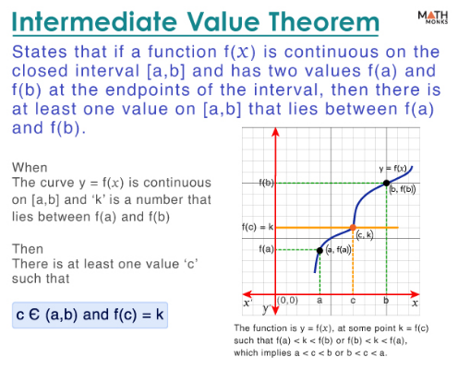

MATHEMATICAL FOUNDATION
INTERMEDIATE VALUE THEOREM (IVT)
The method relies on a simple mathematical truth:
"If a continuous function $f(x)$ is positive at one point and negative at another, it must cross zero somewhere in between."
This "sign change" confirms a root exists in the interval $[a, b]$.

Slide 5





THE ALGORITHM: 3 SIMPLE STEPS
1. CHOOSE INTERVAL
2. BISECT
3. UPDATE & REPEAT
Pick two initial guesses, $a$ and $b$, such that $f(a)$ and $f(b)$ have opposite signs.
Calculate the midpoint $c$. This is your new best guess for the root.
If $f(a) \cdot f(c) < 0$, the root is in the left half. Set $b = c$. Otherwise, set $a = c$.

Slide 6

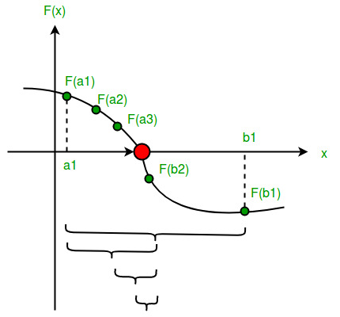
VISUALIZING THE PROCESS
ZEROING IN
Notice how the brackets $[a, b]$ clearly trap the root.
Iteration 1: The gap is large.
Iteration 2: The gap is cut in half.
Iteration 3: The gap is quartered.
We repeat this until the interval is tinier than our required tolerance (e.g., 0.0001).

Slide 7
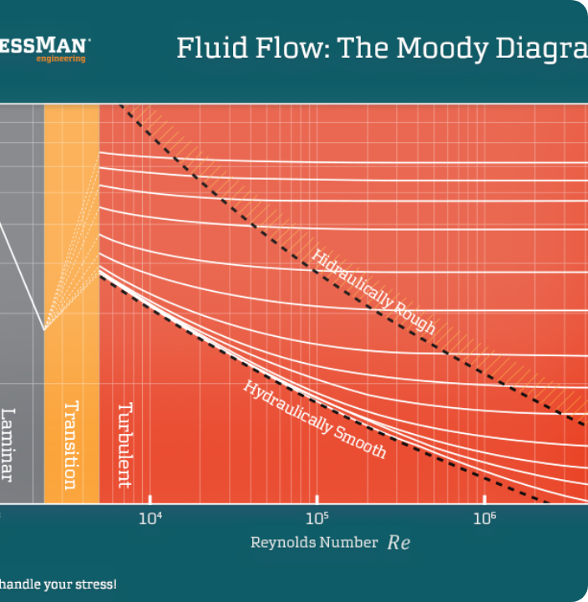

REAL WORLD: FLUID MECHANICS
THE COLEBROOK EQUATION
Civil and Mechanical engineers use this equation to calculate friction ($f$) inside turbulent pipes. It's crucial for designing pump systems.
Notice that $f$ is on both the left and right sides inside a logarithm. You cannot solve for $f$ algebraically. Bisection is the standard way to solve this.

Slide 8
EXAMPLE: SOLVING $X^3 - X - 2 = 0$
Iter | a (Low) | b (High) | c (Midpoint) | f(c) | Action
1 | 1.0000 | 2.0000 | 1.5000 | -0.125 (Negative) | Replace a
2 | 1.5000 | 2.0000 | 1.7500 | +1.609 (Positive) | Replace b
3 | 1.5000 | 1.7500 | 1.6250 | +0.666 (Positive) | Replace b
4 | 1.5000 | 1.6250 | 1.5625 | +0.252 (Positive) | Replace b
Notice how the midpoint c is slowly converging towards the true root (~1.521).

Slide 9


METHOD EVALUATION
ADVANTAGES
DISADVANTAGES
Guaranteed Convergence: If the interval is correct, it will 100% find the root.
Slow Speed: It converges "linearly." It takes many steps to get high precision.
Simple: No calculus or derivatives required.
Guessing Required: You must know two initial points that bracket the root.
Error Bound: You know exactly how accurate you are at any step.

Slide 10
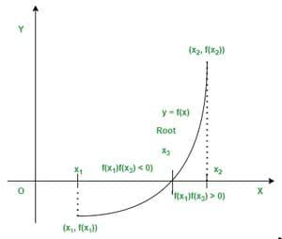
COMPARISON: SPEED VS. SAFETY
BISECTION VS. NEWTON-RAPHSON
Think of Bisection as a Tortoise and Newton-Raphson as a Hare.
•
Newton-Raphson uses the slope (derivative) to jump straight to the answer. It is extremely fast but can crash (diverge) if the function is weird.
•
Bisection methodically cuts the space in half. It is slower, but it never fails.

Slide 11
CONCLUSION
The Bisection method is the bedrock of numerical analysis.
While simpler than advanced optimization algorithms used in AI (like Gradient Descent), it teaches us the fundamental principle of computational engineering: Iterative Refinement.
When safety and reliability matter more than raw speed, Bisection is still the engineer's choice.

Slide 12
Q & A
Thank you for listening.

